Slide 1
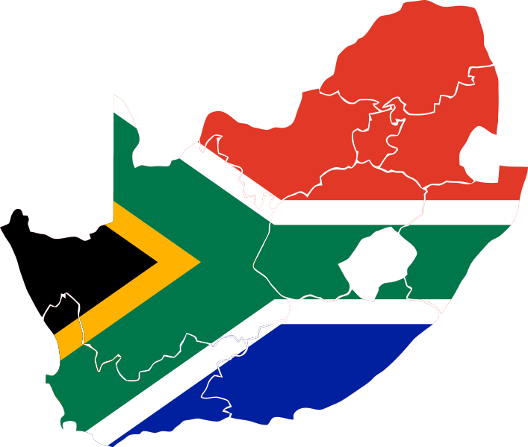
Languages of south africa
By Musa Baloyi
Notes:
I’m presenting you with a survival guide in case you go on assignment to the ThoughtWorks office in South Africa. I’ll also give you some historical perspective to enable you to have a deeper understanding of the whole subject of South African languages. I’ll try my best to give you some examples so you can get a better feel of these languages.

Slide 2
11 official languages
Afrikaans
English
Isindebele
Isixhosa
Isizulu
Sesotho sa Lebowa
Sesotho
Setswana
Siswati
Tshivenda
Xitsonga
Notes:
SA has possibly the most number of official languages in the world. These are the languages that government is obliged to use and/or offer services in. Meaning, any citizen can demand to be catered to in any of these 11 languages.

Slide 3
The simple version
Ndebele
Pedi (northern Sotho)
Sotho
Swati
Tsonga
Tswana
Venda
Xhosa
Zulu
Afrikaans
English
Isindebele
Isixhosa
Isizulu
Sesotho sa Lebowa
Sesotho
Setswana
Siswati
Tshivenda
Xitsonga
Notes:
Because it is difficult to remember what prefixes to use for which languages, the root words are used. In other words: Ndebele instead of IsiNdebele, Kwa-Ndebele or AmaNdebele. Using just Ndebele will suffice for all cases.

Slide 4
Misnomers
Tsonga vs Shangaan
Soshangana – circa 1825
Shangaan = Tsonga + Nguni
6 dialects for “standard” Tsonga
Tswa-Ronga family of languages
Tsonga, Ronga, Tswa, Chopi, Tonga, Ndau
Each with its own dialects
Northern Sotho vs Pedi
Biggest dialect
Pulane, Lobedu
Western Sotho vs Tswana
Agreement
Notes:
One writer has said that it is impossible to have one unifying name for large tribes because there could be many differences among the people. We try to find the most descriptive, albeit not perfect, name for each ethnolinguistic group.

Slide 5
6 Language Families
Afrikaans
English
Nguni: Ndebele, Zulu, Xhosa, Swati
Sotho-Tswana: Sotho, Pedi, Tswana
Tswa-Ronga: Tsonga
Venda
Notes:
When a language has a big population, dialects tend to be treated as languages. This is the case for Sotho, Pedi and Tswana. They are dialects of Sotho with sub-dialects but they are treated as languages with dialects. A similar situation exists for Tsonga in Mozambique. The construct of “language families” becomes particularly useful in these instances.

Slide 6
Language of…
NGUNI
Language of the Ndebele – Isindebele
Language of the Xhosa - Isixhosa
Language of the Zulu - Isizulu
Language of the Swati - Siswati
SOTHO-TSWANA (SOTHO)
Language of the Pedi - Sepedi
Language of the Sotho - Sesotho
Language of the Tswana - Setswana
TSWA-RONGA (TSONGA)
Language of the Tsonga – Xitsonga
VENDA
Language of the Venda - Tshivenda
Notes:
To drive the point that there are actually 6 languages in SA, take a look at the prefixes used for the language groups. They are uniform for all. Isi- for Nguni, Se- for Sotho, etc etc.

Slide 7
People of…
NGUNI
Ndebele people – Amandebele
Xhosa people – Amaxhosa
Zulu people – Amazulu
Swati people - Amaswati
SOTHO-TSWANA (SOTHO)
Pedi people – Bapedi
Sotho people – Basotho
Tswana people - Batswana
TSWA-RONGA (TSONGA)
Tsonga people – Vatsonga
VENDA
Venda people - Vhavenda
Notes:
The prefixes that are used for “people of” as consistent with the language families. For Nguni we use Ama-. The other groups use the same prefix but different spellings. Ba-, Va-, and Vha- are more or less pronounced the same.

Slide 8
Orthographies
Within borders
Across borders
Nguni | Sotho | Tsonga | Venda
isiNguni, IsiNguni | Sesotho | Xitsonga | Tshivenda
amaNguni, AmaNguni | Basotho | Vatsonga | Vhavenda
 | ca/ka | nha/nya
Moz. | Ricatla | Inhambane
R.S.A. | Rikatla | Nyembane
Notes:
That brings us to orthography. Although all the SA languages use the Latin alphabet, the orthographies differ quite vastly. For cross-border languages the same situation persists. It is worse because most people are not aware of these differences, as opposed to in-country differences.

Slide 9
Land of…
With particular reference to the Tsonga
According to apartheid
Gazankulu
According to the Berlin Conference
Mozambique, South Africa, Swaziland, Zimbabwe
Maputaland/Thongaland
This concept does not exist
According to the people
Vukalanga (Zimbabwe)
Hlengweni (Mozambique)
Wutonga (Inhambane, Mozambique)
Same concepts across all native South Africans
Notes:
I wish I could say “land of” continues in the same systematic way as before, but not so. It is affected by three issues. The apartheid government came and said, Vatsonga Vatsongeni – Tsonga people should stay together. But before that, we had the Berlin Conference which divided southern Africa into countries so the British and Portuguese would stop fighting over land. But even before that, the people called their lands by different names and the borders were different from what they are today.

Slide 10
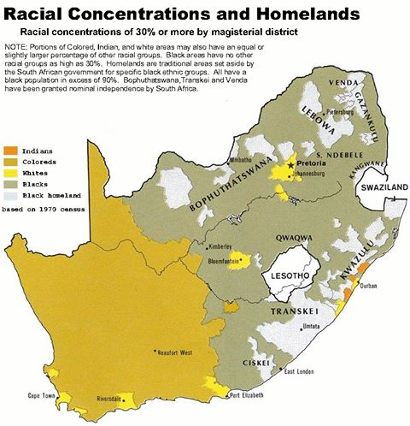
According to apartheid
Notes:
We had black people mixing freely and speaking all kinds of languages but they were separated into homelands, one for each “language” as defined by colonial linguists. For example, my village was predominantly Tsonga so all the Venda people were moved out. The reggae musician Colbert Mukwevho, a Venda, is one of the people that were evicted. A special case is the Xhosa, who had 2 homelands.

Slide 11
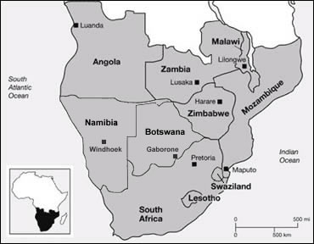
According to the Berlin Conference
Notes:
Zimbabwe, SA, Swaziland, Mozambique and Lesotho were created. People that spoke the same language found that they could not interact freely. For example, the Ronga people of northern Kwa-Zulu Natal in South Africa were split from the ones in what is now Maputo.

Slide 12
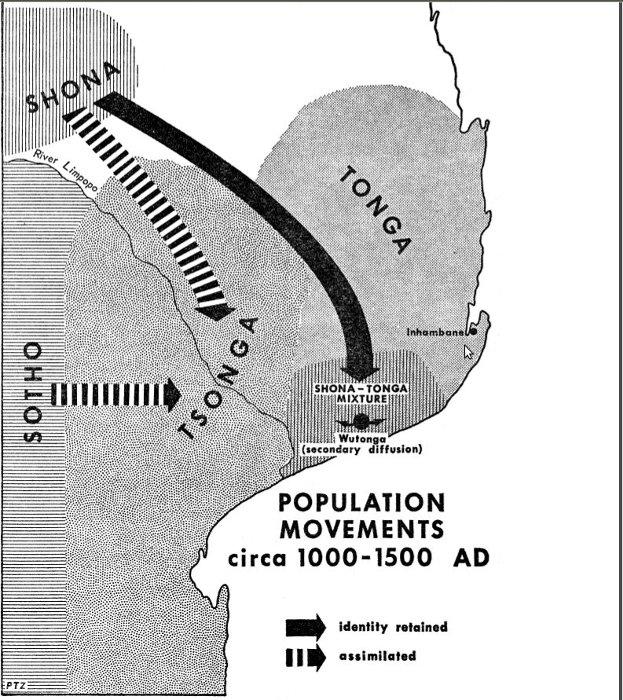
According to the People
Notes:
The Chopi are a mixture of Tsonga, Shona and Tonga so there are no clear distinctions between languages. Some say “timbila” while others say “timbira”. In fact, the names of the people are a recent phenomenon. There was no such thing as Copi, Shona or Tsonga until the 19th century.

Slide 13
South African English
Spelling
Mostly British
Nguni words
Ubuntu
Sangoma
Indaba
Muti
Sotho words
Lekgotla
Afrikaans words
Braai
Lekker
Pap en vleis
Tsonga and Venda words?
Notes:
English has been customised. Some customisations include “ubuntu” for humanity; “braai” for barbecue. My only concern is that not all South African languages are represented in the official South African English dictionary so I prefer to speak British English whenever I can.

Slide 14
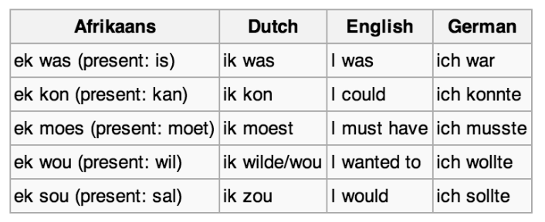
Afrikaans
Afrikaans vs old Dutch/German
Source: http://en.wikipedia.org/wiki/Afrikaans
Notes:
Dutch has evolved and so has Afrikaans such that although the languages are intelligible, there are noticeable differences. After all, Afrikaans was based on an old version of Dutch and nobody speaks that anymore. Other Afrikaans words like “boet” for brother and “kerk” for church have found their way into the vocabulary of black South Africans.

Slide 15
Tsotsitaal
From Afrikaans
Eintlek
Oorkant
Waai
From English
Sharp
Sure
From Bantu
Zwakala
Qava
Unknown origin
Heita
Holla
Kwaito music
Notes:
Kwaito, a musical genre, was very instrumental in the development of Tsotsi taal. Tsotsi taal is slang based off Afrikaans and other made up words. This language is slowly dying as the genre of music is no longer popular.

Slide 16
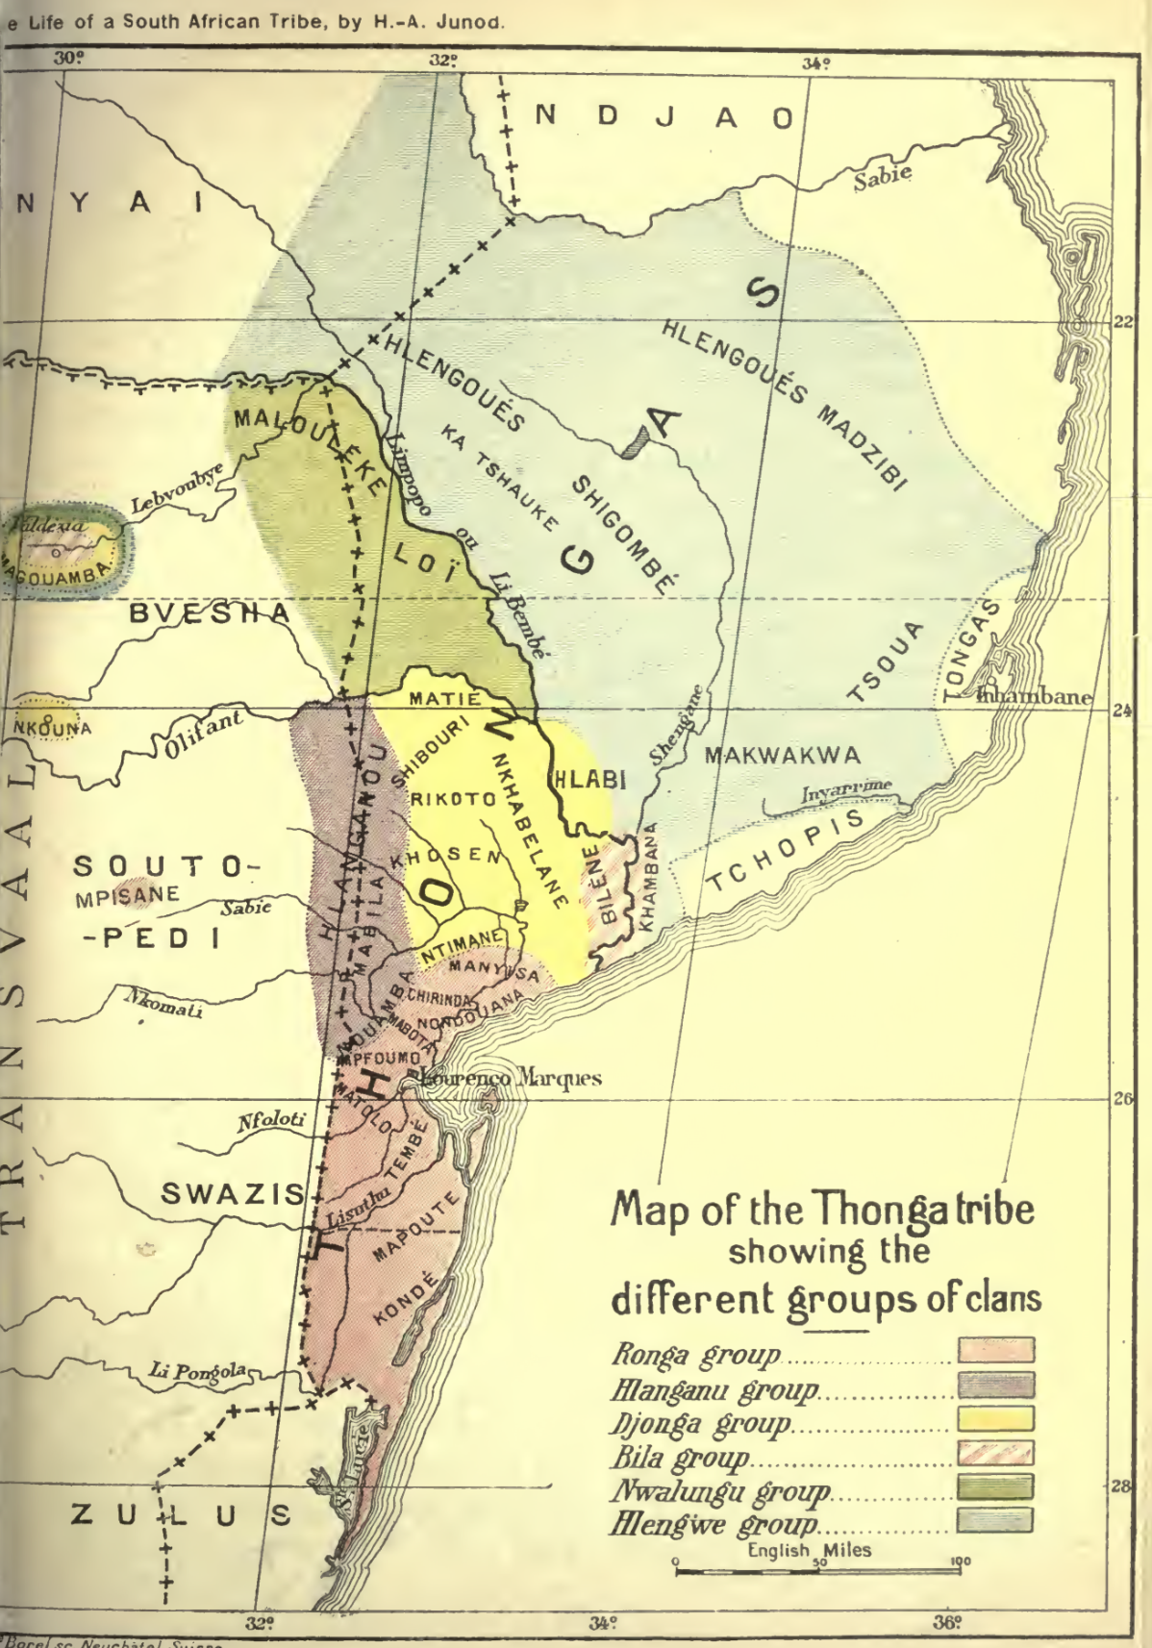
Dialects
Notes:
According to myself based on information from all over the world, Tswa-Ronga people and languages are: Chopi, Ndau, Ronga, Tsonga, Tonga and Tswa.
Chopi (Chope, Copi, Tshopi, Txopi) dialects are Copi, Khambani, Lambwe, Lenge (Lengue), Ndonge and Tonga.
Ndau (Ndzawu, Njao, Sofala, South-East Shona) dialects are Changa (Shanga, Xanga), Danda, Dondo, Gova, Ndau, and Senji.
Ronga (Rhonga) dialects are Kalanga, Konde, Putru, and Ssonge.
Tsonga (aka standard or South African Tsonga) dialects are Bila (Vila), Changana (Shangaan, Shangana), Dzonga (Jonga), Gwamba (Gwapa), Hlanganu (Langanu, Nhlanganu), Hlave (Mbayi, Nkuna, Pai), Kande, Khosa, Luleke, N'walungu (Ngwalungu), Nkuma, Songa, Xika, and Xonga.
Tswa (Tshwa) dialects are Dzibi (Dzivi), Dzibi-Dzonga (Dzivi-Dzonga), Tshwa, Hlengwe (Lengwe, Lhenge), Khambani, Makwakwe-Khambani, Mandla, Ndxhonge, and Nhayi (Nyai, Nyayi).
Tonga can be divided into Valley Tonga and Plateau Tonga, and is spoken by Ila, Iwe, Leya, Toka and Tonga people.
Tswa-Ronga dialects not considered part of the family include Pulana (Xipulana, Sepulane).
It has been said that the two dialects that unite all Tswa-Ronga languages are Nkuna and Khosa (HP Junod, Matimu ya Vatsonga).

Slide 17
Cross-border languages
Lesotho
Sotho
Botswana
Sotho
Swaziland
Nguni, Tsonga, Sotho
Mozambique
Tsonga
Namibia
Afrikaans
Zimbabwe
Nguni, Tsonga, Venda, Sotho
Notes:
In addition to South Africa, Sotho is spoken in Lesotho, Botswana, Swaziland and Zimbabwe. Nguni in Swaziland and Zimbabwe. Tsonga in Swaziland, Mozambique and Zimbabwe. Venda in Zimbabwe and Afrikaans in Namibia.

Slide 18
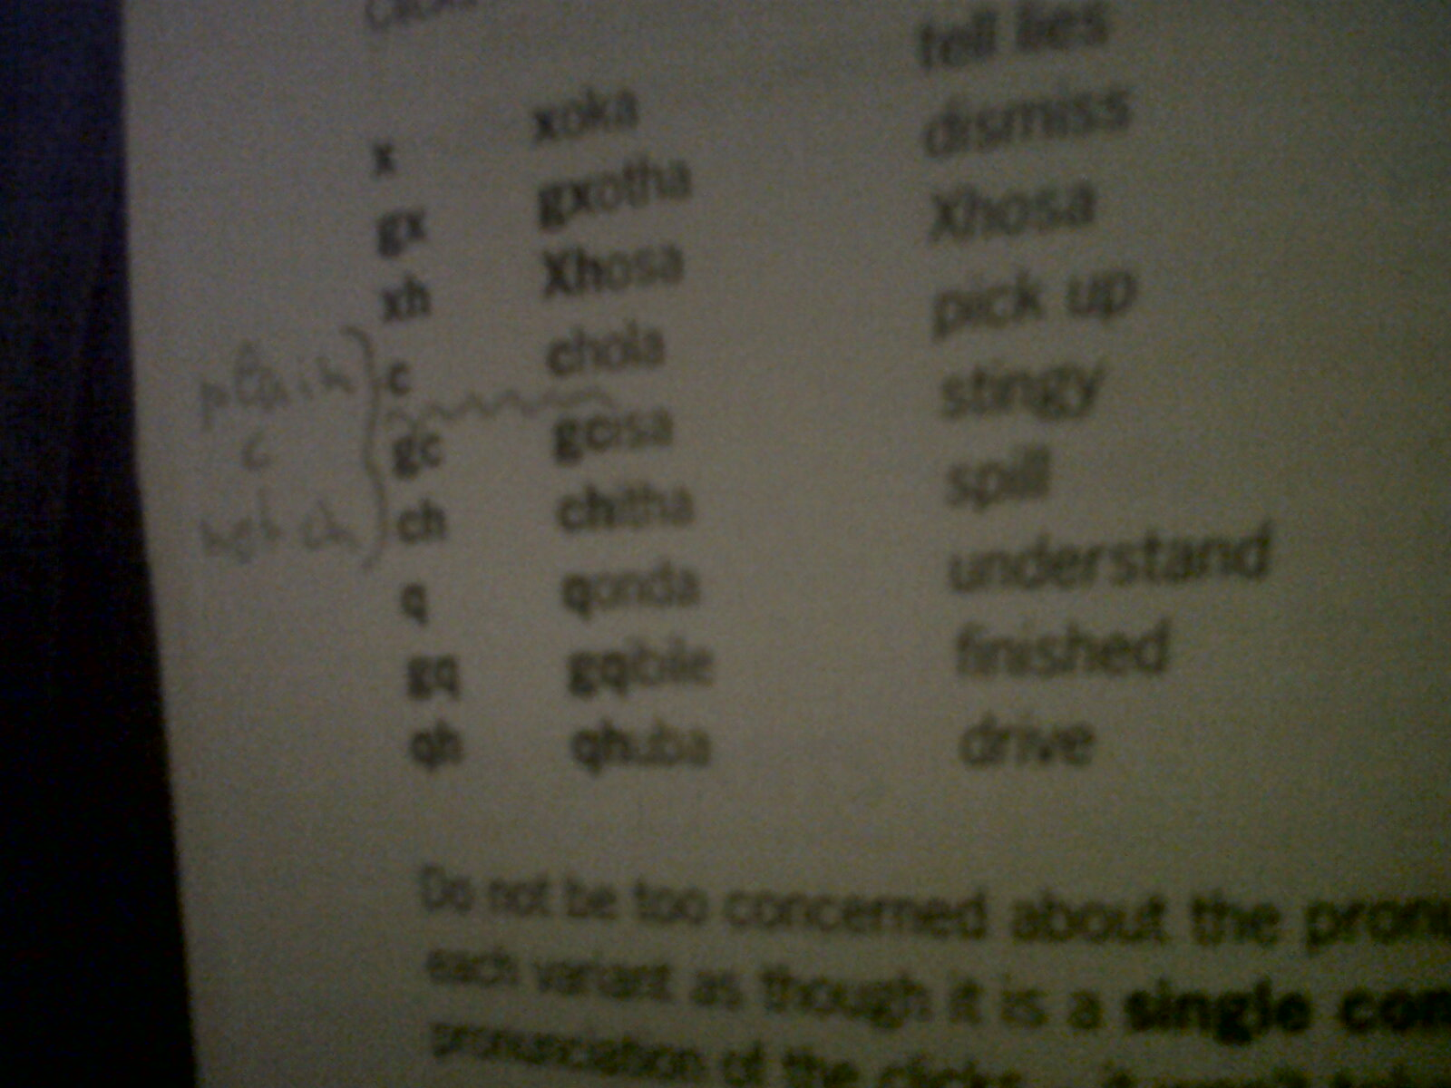
Clicking languages
Khoi-San
First in southern Africa
Bushmen, Hottentots
Northern Cape, Botswana
Nguni
Xhosa clicks
Tsonga clicks?
Quvavhanga, qokolela, quva
Whistling language: xi-, swi-
Notes:
The Nguni got their clicks from the Khoi-San. Xhosa has the most variety of clicks after the Khoi-San languages. Tsonga has some clicks that are not found in Nguni languages but it is what they call a “whistling” language. Clicks in Tsonga are spelt satisfactorily with the letter “q”.

Slide 19
Greetings
Nguni
Sawubona/Sanibonani
Molo/Molweni
Sotho
O kae/le kae
Dumela/Dumelang
Thobela
Tsonga
Morning: Avuxeni/Ri xile
Afternoon: I nhlikani
Evening: Ri perile
Venda
Males: Ndaa!
Females: Aa!

Slide 20

Language in Music
House: Ganyani - Xigubu
Traditional: Xinyori – Hi khome ku tika
Gospel: Tintswalo Mndlovu – Hi hanya mahala
Notes:
Hasani Chauke, also known as Xinyori, got a doctorate for language, not music, from the University of Venda. A second university, the University of Limpopo, admitted to having had similar plans. His use of language is witty, rhythmic and educational, to say the least.

